Slide 1
Effects of Herbicide Chemicals on Soil Communities
Amy Barfield Presents:

Slide 2
Effects of Herbicide Chemicals on Soil Communities
Amy Barfield
The question I will be asking with my data is: how are single-celled organisms in soil affected by the different herbicide chemicals?

Slide 3
Motivation and Background
Compelling reasons to study my question
Herbicides are ubiquitous but they are not regulated and their chemical formulations are not publically available
Most attention has been the active ingredients (like glyphosate) but less is known about the “surfactants” mixed in
Previous research has shown adjuvant chemicals can be more toxic than glyphosate itself
Soil microbial communities are very important for the whole ecosystem!
Soil is cool!

Slide 4
Approach
I will answer this question by using data collected by the Schmidt Alpine Microbial Observatory
The year? Fall 2018
The plan? Collect soil from Chatfield Farms in Denver. Put the soil in microcosms (petri dishes). Apply chemicals. See what does, or doesn’t, grow (over 3.5 weeks).

Slide 5
Approach
Wait, what chemicals? Herbicide chemicals!
5 Treatments:
Glyphosate
The active ingredient in many commonly used herbicides like RoundUp
AgriDex
A commonly used surfactant agent
Surfactant? An adjuvant (additive) chemical that increases toxicity and helps glyphosate stay in environment longer
Glyphosate + AgriDex
ProMax
A manufactured herbicide similar to RoundUp
No treatment (control)

Slide 6
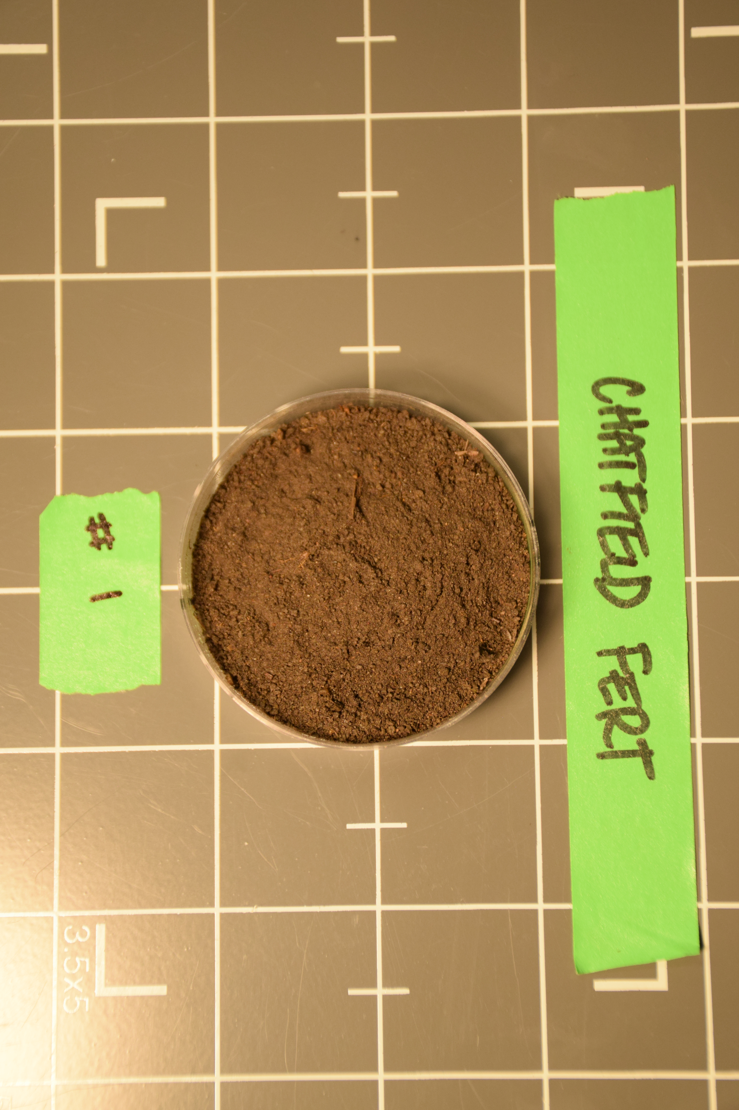
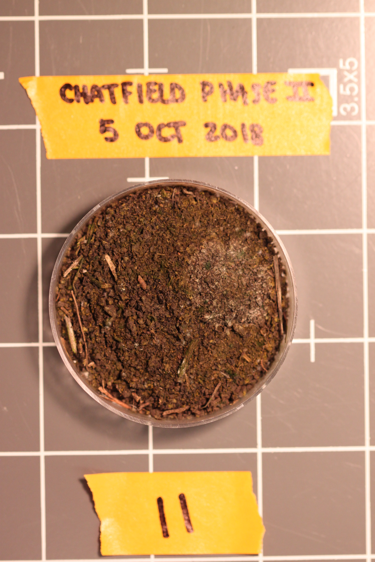

Slide 7
About the Data
Observed cyanobacteria, diatoms, moss, fungi, other growth on microcosms
Point-intercept method: looked at microcosms under microscope with ‘reticule’. When growth was observed in cross-hairs it was recorded. Looked 100+ times in “randomized grid” pattern
Gives cover/time

Slide 8
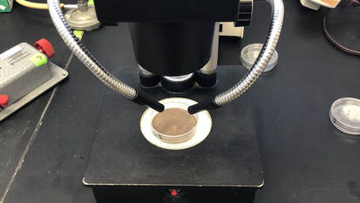

Slide 9
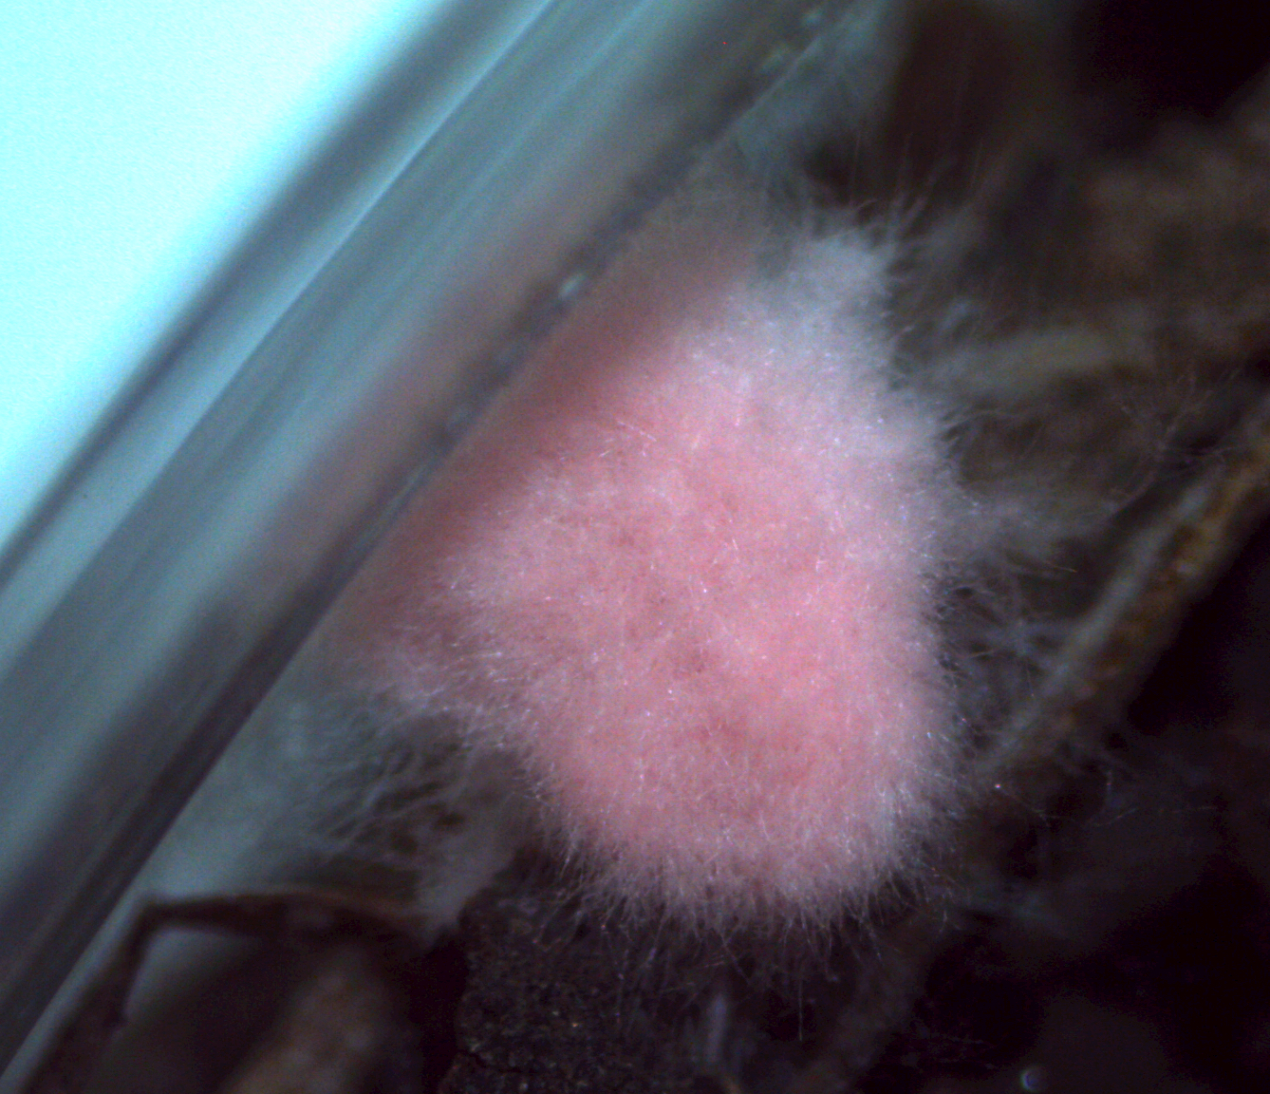
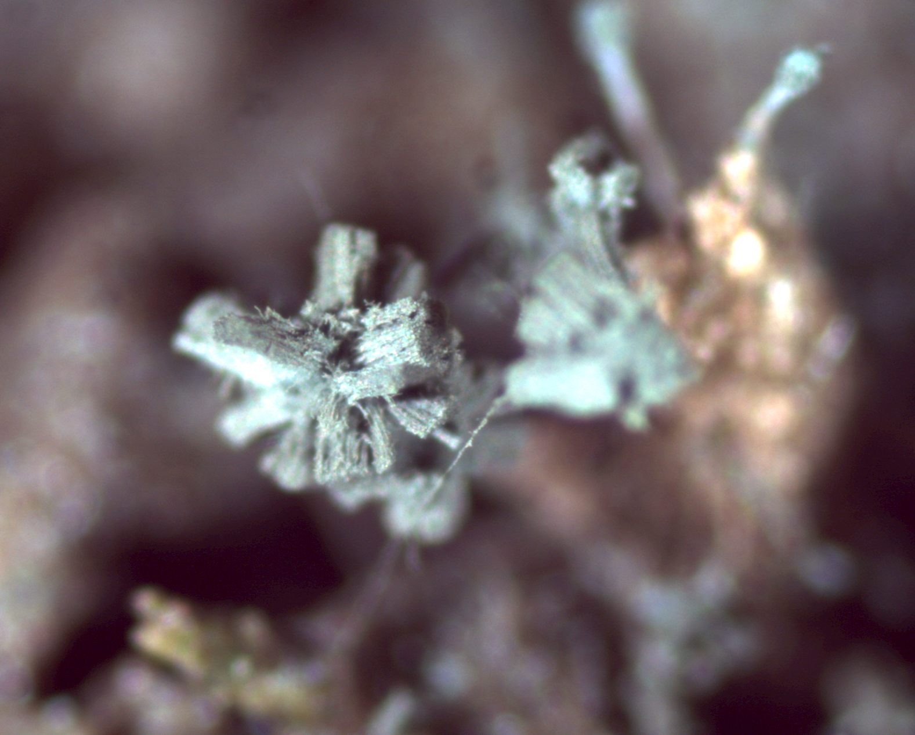
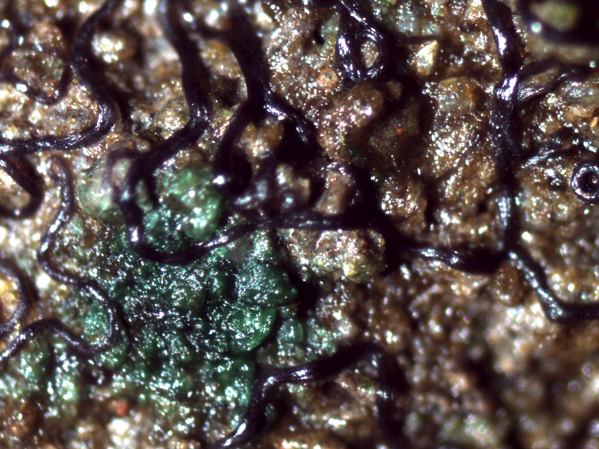
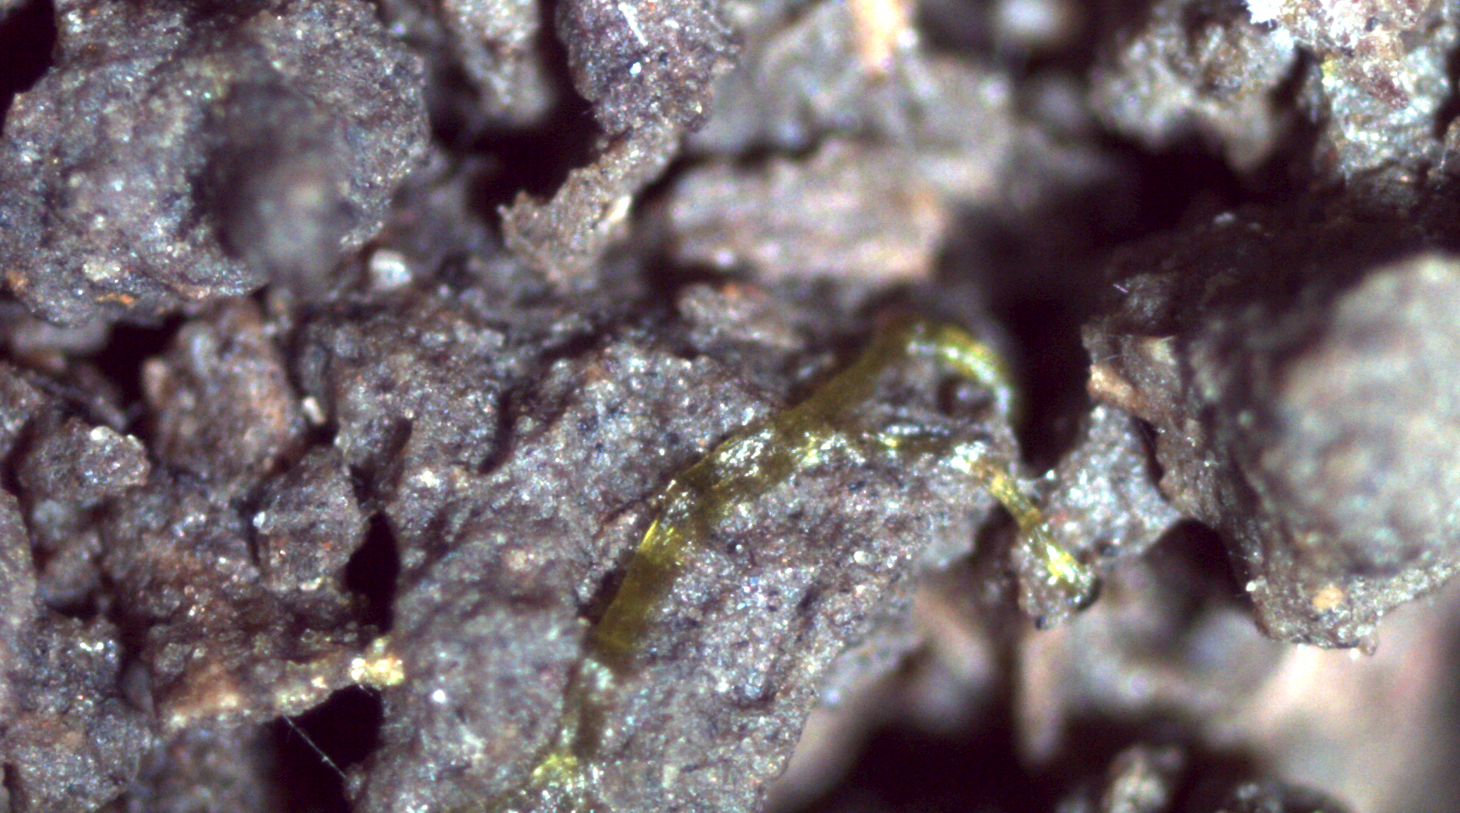

Slide 10
Anticipated Details
The analysis will involve …
% cover/time
Growth rate
Final % cover
Comparing different treatments
Seeing what grows… or doesn’t

Slide 11
Anticipated Results
Adjuvant chemicals are deadly!
I master ggplot and become graphical hacker genius!

